Slide 1
Database Management System
Lecture # 9-10

Slide 2
SQL as the standard language
Oracle SQL complies/fulfills with industry-accepted standards.
Oracle Corporation ensures future compliance with evolving standards by actively involving key personnel in SQL standards committees.
Industry-accepted committees are the American National Standards Institute (ANSI) and the International Standards Organization (ISO).
Both ANSI and ISO have accepted SQL as the standard language for relational databases.

Slide 3
SQL as the standard language
Although SQL is an ANSI/ISO standard, there are many different versions of the SQL language.
However, to be compliant with the ANSI/ISO standard, they all support at least the major commands
(such as SELECT, UPDATE, DELETE, INSERT, WHERE) in a similar manner.
Note: Most of the SQL database programs also have their own proprietary/exclusive/patented/copyrighted extensions in addition to the SQL standard!
Note: SQL is not case sensitive

Slide 4
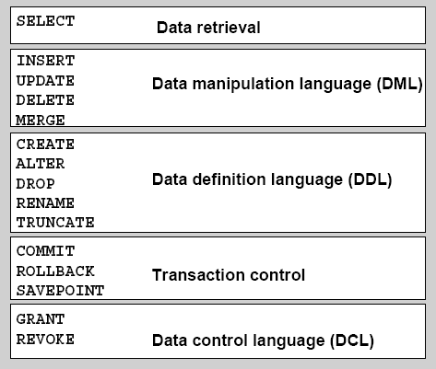
SQL Statements
■
DRL - Retrieves data from the database
■
DML - Enters new rows, changes existing rows, and removes unwanted rows from tables in the database, respectively.
■
DDL - Sets up, changes, and removes data structures from tables.
■
TCL - Manages the changes made by DML statements. Changes to the data can be grouped together into logical transactions.
■
DCL - Gives or removes access rights to both the Oracle database and the structures within it.

Slide 5
Capabilities of SQL SELECT Statements
Projection
Selection
Table 1
Table 1
Join
Table 1
Table 2
Notes:
Capabilities of SQL SELECT Statements
A SELECT statement retrieves information from the database. With a SELECT statement, you can use the following capabilities:
Projection: Choose the columns in a table that are returned by a query. Choose as few or as many of the columns as needed
Selection: Choose the rows in a table that are returned by a query. Various criteria can be used to restrict the rows that are retrieved.
Joining: Bring together data that is stored in different tables by specifying the link between them. SQL joins are covered in more detail in a later lesson.

Slide 6
Basic SELECT Statement
The SELECT statement is used to select data from a database.
The result is stored in a result table, called the result-set.
The main element in a SQL query is the SELECT statement.
A properly written SELECT statement will always produce a result in the form of one or more rows of output.
The SELECT statement chooses (selects) rows from one or more tables according to specific criteria.
Some SQL version use ; as a statement terminator

Slide 7
Basic SELECT Statement
Main use is to extract data from the database, by using a SELECT statement, you can do the following:
Projection:
choose the columns in a table that you want returned by your query. You can choose as few or as many columns of the table as you require.
Selection:
choose the rows in a table that you want returned by a query. You can use various criteria to restrict the rows that you see.
Joining:
Bring together data that is stored in different tables by creating a link between them.

Slide 8
Basic SELECT Statement Syntax
SELECT column_name(s)
FROM table_name
and
SELECT * FROM table_name
The asterisk (*) is a quick way of selecting all columns
e.g
SELECT * FROM Employee

Slide 9
SELECT Distinct Statement
In a table, some of the columns may contain duplicate values. This is not a problem, however, sometimes you will want to list only the different (distinct) values in a table.
Used in eliminating duplicate rows
The DISTINCT keyword can be used to return only distinct (different) values.
SQL SELECT DISTINCT Syntax
SELECT DISTINCT column_name(s)
FROM table_name
e.g
SELECT DISTINCT City FROM Employee

Slide 10
SQL Where Clause
The WHERE clause is used to extract only those records that fulfill a specified criterion.
SQL WHERE Syntax
SELECT column_name(s)
FROM table_name
WHERE column_name operator value/condition
e.g
SELECT * FROM Employee
WHERE City=‘islamabad'

Slide 11
Use of Quotes in SQL
SQL uses single quotes around text values (most database systems will also accept double quotes).
Although, numeric values should not be enclosed in quotes.
For text values:
This is correct:
SELECT * FROM EmployeeWHERE FirstName=‘Ahmad'
This is wrong:
SELECT * FROM Employee WHERE FirstName= Ahmad

Slide 12
Use of Quotes in SQL
For numeric values:
This is correct:
SELECT * FROM Employee WHERE Age=60
This is wrong:
SELECT * FROM Employee WHERE Year='60'

Slide 13
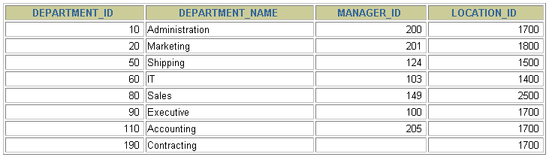
Selecting All Columns
SELECT *
FROM departments;
Notes:
Selecting All Columns of All Rows
You can display all columns of data in a table by following the SELECT keyword with an asterisk (*). In the example in the slide, the department table contains four columns: DEPARTMENT_ID, DEPARTMENT_NAME, MANAGER_ID, and LOCATION_ID. The table contains seven rows, one for each department.
You can also display all columns in the table by listing all the columns after the SELECT keyword. For example, the following SQL statement (like the example in the slide) displays all columns and all rows of the DEPARTMENTS table:
SELECT department_id, department_name, manager_id, location_id FROM departments;

Slide 14
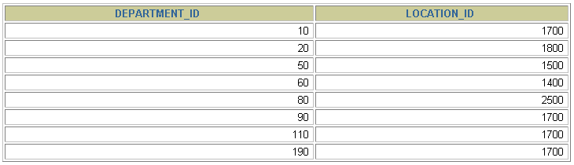
Selecting Specific Columns
SELECT department_id, location_id
FROM departments;
Notes:
Selecting Specific Columns of All Rows
You can use the SELECT statement to display specific columns of the table by specifying the column names, separated by commas. The example in the slide displays all the department numbers and location numbers from the DEPARTMENTS table.
In the SELECT clause, specify the columns that you want, in the order in which you want them to appear in the output. For example, to display location before department number going from left to right, you use the following statement:
SELECT location_id, department_id
FROM departments;

Slide 15
Writing SQL Statements
SQL statements are not case-sensitive.
SQL statements can be on one or more lines.
Keywords cannot be abbreviated or split across lines.
Clauses are usually placed on separate lines.
Indents are used to enhance readability.
In iSQL*Plus, SQL statements can optionally be terminated by a semicolon (;) Semicolons are required if you execute multiple SQL statements.
In SQL*plus, you are required to end each SQL statement with a semicolon (;).

Slide 16
Arithmetic Expressions
Create expressions with number and date data by using arithmetic operators.
Operator | Description
+ | Add
- | Subtract
* | Multiply
/ | Divide
Notes:
Arithmetic Expressions
You may need to modify the way in which data is displayed, or you may want to perform calculations or look at what-if scenarios. These are all possible using arithmetic expressions. An arithmetic expression can contain column names, constant numeric values, and the arithmetic operators.
Arithmetic Operators
The slide lists the arithmetic operators that are available in SQL. You can use arithmetic operators in any clause of a SQL statement (except the FROM clause).
Note: With DATE and TIMESTAMP data types, you can use the addition and subtraction operators only.

Slide 17
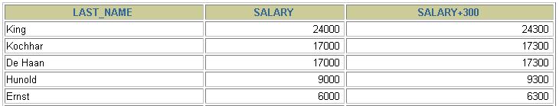
Using Arithmetic Operators
SELECT last_name, salary, salary + 300
FROM employees;
…
Notes:
Using Arithmetic Operators
The example in the slide uses the addition operator to calculate a salary increase of $300 for all employees. The slide also displays a SALARY+300 column in the output.
Note that the resultant calculated column SALARY+300 is not a new column in the EMPLOYEES table; it is for display only. By default, the name of a new column comes from the calculation that generated it—in this case, salary+300.
Note: The Oracle server ignores blank spaces before and after the arithmetic operator.
Operator Precedence
If an arithmetic expression contains more than one operator, multiplication and division are evaluated first. If operators in an expression are of the same priority, then evaluation is done from left to right.
You can use parentheses to force the expression that is enclosed by parentheses to be evaluated first.
Rules of Precedence:
Multiplication and division occur before addition and subtraction.
Operators of the same priority are evaluated from left to right.
Parentheses are used to override the default precedence or to clarify the statement.

Slide 18


Operator Precedence
SELECT last_name, salary, 12*salary+100
FROM employees;
1
…
SELECT last_name, salary, 12*(salary+100)
FROM employees;
2
…
Notes:
Operator Precedence (continued)
The first example in the slide displays the last name, salary, and annual compensation of employees. It calculates the annual compensation by multiplying the monthly salary by 12, plus a one-time bonus of $100. Notice that multiplication is performed before addition.
Note: Use parentheses to reinforce the standard order of precedence and to improve clarity. For example, the expression in the slide can be written as (12*salary)+100 with no change in the result.
Using Parentheses
You can override the rules of precedence by using parentheses to specify the desired order in which operators are to be executed.
The second example in the slide displays the last name, salary, and annual compensation of employees. It calculates the annual compensation as follows: adding a monthly bonus of $100 to the monthly salary, and then multiplying that subtotal by 12. Because of the parentheses, addition takes priority over multiplication.

Slide 19
Defining a Null Value
A null is a value that is unavailable, unassigned, unknown, or inapplicable.
A null is not the same as zero or a blank space. Zero is a number, and a space is a character.
If a row lacks the data value for a particular column, that value is said to be null, or to contain a null.
If any column value in an arithmetic expression is null, the result is null.
For example, if you attempt to perform division with zero, you get an error. However, if you divide a number by null, the result is a null or unknown.

Slide 20
Defining a Null Value
SELECT last_name, job_id, salary, commission_pct
FROM employees;
…
…
Notes:
Null Values
If a row lacks a data value for a particular column, that value is said to be null or to contain a null.
A null is a value that is unavailable, unassigned, unknown, or inapplicable. A null is not the same as a zero or a space. Zero is a number, and a space is a character.
Columns of any data type can contain nulls. However, some constraints (NOT NULL and PRIMARY KEY) prevent nulls from being used in the column.
In the COMMISSION_PCT column in the EMPLOYEES table, notice that only a sales manager or sales representative can earn a commission. Other employees are not entitled to earn commissions. A null represents that fact.

Slide 21
Defining a Column Alias
A column alias:
Renames a column heading
Is useful with calculations
Immediately follows the column name (There can also be the optional AS keyword between the column name and alias.)
Requires double quotation marks if it contains spaces or special characters or if it is case-sensitive

Slide 22


Using Column Aliases
SELECT last_name AS name, commission_pct comm
FROM employees;
…
SELECT last_name "Name" , salary*12 "Annual Salary"
FROM employees;
…
Notes:
Column Aliases (continued)
The first example displays the names and the commission percentages of all the employees. Notice that the optional AS keyword has been used before the column alias name. The result of the query is the same whether the AS keyword is used or not. Also notice that the SQL statement has the column aliases, name and comm, in lowercase, whereas the result of the query displays the column headings in uppercase. As mentioned in a previous slide, column headings appear in uppercase by default.
The second example displays the last names and annual salaries of all the employees. Because Annual Salary contains a space, it has been enclosed in double quotation marks. Notice that the column heading in the output is exactly the same as the column alias.

Slide 23

Concatenation Operator
A concatenation operator:
Links columns or character strings to other columns
Is represented by two vertical bars (||)
Creates a resultant column that is a character expression
SELECT last_name||job_id AS "Employees"
FROM employees;
…
Notes:
Concatenation Operator
You can link columns to other columns, arithmetic expressions, or constant values to create a character expression by using the concatenation operator (||). Columns on either side of the operator are combined to make a single output column.
In the example, LAST_NAME and JOB_ID are concatenated, and they are given the alias Employees. Notice that the employee last name and job code are combined to make a single output column.
The AS keyword before the alias name makes the SELECT clause easier to read.
Null Values with the Concatenation Operator
If you concatenate a null value with a character string, the result is a character string. LAST_NAME || NULL results in LAST_NAME.

Slide 24
Literal Character Strings
A literal is a character, a number, or a date that is included in the SELECT statement.
Date and character literal values must be enclosed by single quotation marks.
Each character string is output once for each row returned.
Notes:
Literal Character Strings
A literal is a character, a number, or a date that is included in the SELECT list and that is not a column name or a column alias. It is printed for each row returned. Literal strings of free-format text can be included in the query result and are treated the same as a column in the SELECT list.
Date and character literals must be enclosed by single quotation marks (' '); number literals need not be so enclosed.

Slide 25
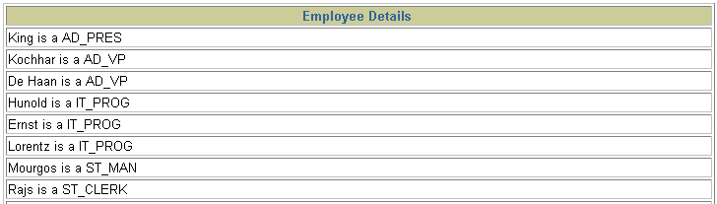
Using Literal Character Strings
SELECT last_name ||' is a '||job_id
AS "Employee Details"
FROM employees;
…
Notes:
Literal Character Strings (continued)
The example in the slide displays last names and job codes of all employees. The column has the heading Employee Details. Notice the spaces between the single quotation marks in the SELECT statement. The spaces improve the readability of the output.
In the following example, the last name and salary for each employee are concatenated with a literal to give the returned rows more meaning:
SELECT last_name ||': 1 Month salary = '||salary Monthly
FROM employees;

Slide 26

Alternative Quote (q) Operator
Specify your own quotation mark delimiter
Choose any delimiter
Increase readability and usability
SELECT department_name ||
q'[, it's assigned Manager Id: ]'
|| manager_id
AS "Department and Manager"
FROM departments;
…
Notes:
Alternative Quote (q) Operator
Many SQL statements use character literals in expressions or conditions. If the literal itself contains a single quotation mark, you can use the quote (q) operator and choose your own quotation mark delimiter
You can choose any convenient delimiter, single-byte or multibyte, or any of the following character pairs: [ ], { }, ( ), or < >.
In the example shown, the string contains a single quotation mark, which is normally interpreted as a delimiter of a character string. By using the q operator, however, the brackets [] are used as the quotation mark delimiter. The string between the brackets delimiters is interpreted as a literal character string.

Slide 27


Duplicate Rows
The default display of queries is all rows, including duplicate rows.
SELECT department_id
FROM employees;
1
…
SELECT DISTINCT department_id
FROM employees;
2
…
Notes:
Duplicate Rows
Unless you indicate otherwise, iSQL*Plus displays the results of a query without eliminating duplicate rows. The first example in the slide displays all the department numbers from the EMPLOYEES table. Notice that the department numbers are repeated.
To eliminate duplicate rows in the result, include the DISTINCT keyword in the SELECT clause immediately after the SELECT keyword. In the second example in the slide, the EMPLOYEES table actually contains 20 rows, but there are only seven unique department numbers in the table.
You can specify multiple columns after the DISTINCT qualifier. The DISTINCT qualifier affects all the selected columns, and the result is every distinct combination of the columns.
SELECT DISTINCT department_id, job_id
FROM employees;

Slide 28
SQL AND & OR Operators
The AND & OR operators are used to filter records based on more than one condition.
The AND operator displays a record if both the first condition and the second condition is true.
The OR operator displays a record if either the first condition or the second condition is true.

Slide 29
SQL AND & OR Operators
Now we want to select only the Employee(s) with the first name equal to “Ahmad" AND the last name equal to “Tayyab":
We use the following SELECT statement:
SELECT * FROM Employee
WHERE FirstName=‘Ahmad'
AND LastName=‘Tayyab'

Slide 30
SQL AND & OR Operators
Now we want to select only the Employee(s) with the first name equal to “Ahmad" OR the first name equal to “Tayyab":
We use the following SELECT statement:
SELECT * FROM Employee
WHERE FirstName=‘Ahmad'
OR FirstName =‘Tayyab'

Slide 31
Combining AND & OR
You can also combine AND and OR (use parenthesis to form complex expressions).
Now we want to select only the Employee(s) with the last name equal to “Ahmad" AND the first name equal to “Tayyab" OR to “Ali":
We use the following SELECT statement:
SELECT * FROM Employee WHERE
LastName=‘Ahmad'
AND (FirstName=Tayyab' OR FirstName=‘Ali')

Slide 32
SQL ORDER BY Keyword
The ORDER BY keyword is used to sort the result-set.
The ORDER BY keyword is used to sort the result-set by a specified column.
The ORDER BY keyword sort the records in ascending order by default.
If you want to sort the records in a descending order, you can use the DESC keyword.

Slide 33
SQL ORDER BY Keyword
SQL ORDER BY Syntax
SELECT column_name(s)
FROM table_name
ORDER BY column_name(s) ASC|DESC
e.g
SELECT *
FROM Employee
ORDER BY age

Slide 34
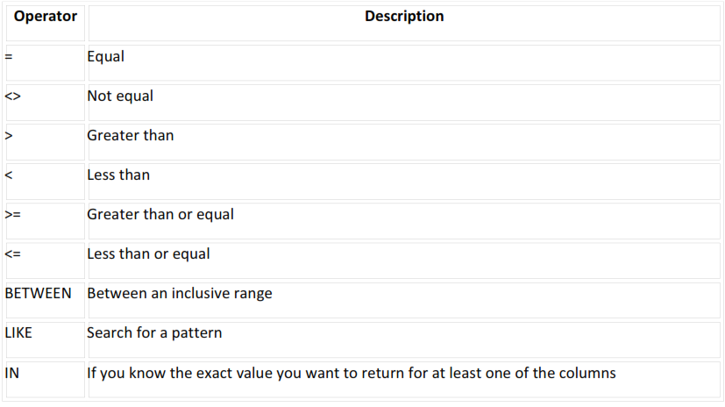
Operators Allowed in the WHERE Clause
Note: In some versions of SQL the <> operator may be written as !=

Slide 35

Character Strings and Dates
Character strings and date values are enclosed in single quotation marks.
Character values are case sensitive, and date values are format sensitive.
The default date format is DD-MON-RR.

Slide 36
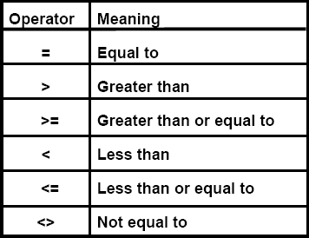
Comparison Conditions
Comparison conditions are used in conditions that compare one expression to another value or expression.
They are used in the WHERE clause.
An alias cannot be used in the WHERE clause.
Note: The symbol != and ^= can also represent the not equal to condition.

Slide 37
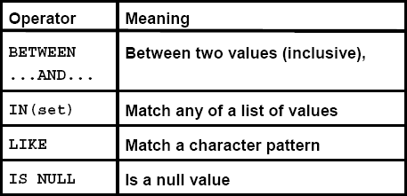
Other Comparison Conditions
■
Use the BETWEEN condition to display rows based on a range of values.
■
Use the IN membership condition to test for values in a list.
■
Use the LIKE condition to perform wildcard searches of valid search string values.
■
Search conditions can contain either literal characters or numbers:
% denotes zero or many characters.
_ denotes one character.
■
Test for nulls with the IS NULL operator.

Slide 38
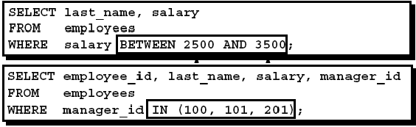



Examples

Slide 39
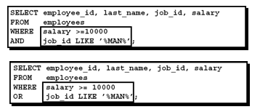
Another Example

Slide 40
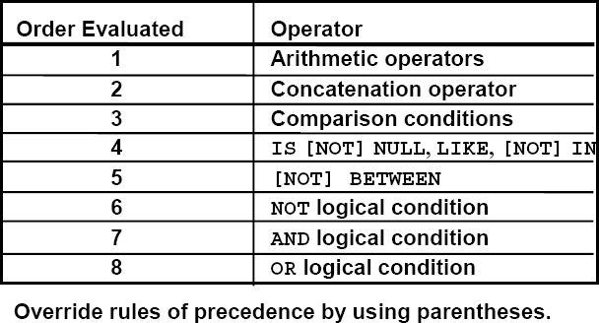
Rules of Precedence

Slide 41
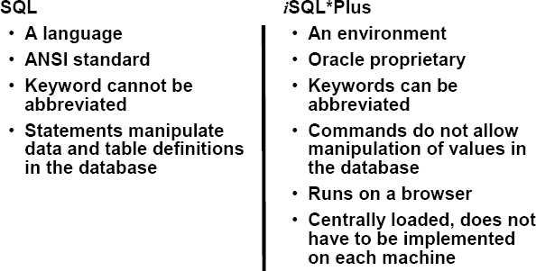
SQL Statements Versus iSQL*Plus Commands

Slide 42
Thanks

